Slide 1
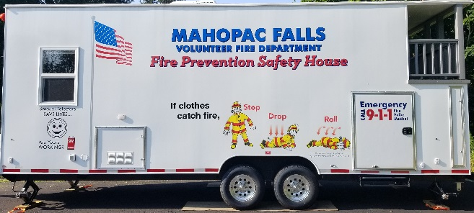
THE MAHOPAC FALLS
VOLUNTEER FIRE DEPARTMENT
Invites you to come down and enjoy a day full of FREE food
& refreshments, plus much more at our
OPEN HOUSE
There will be plenty to see and do:
NEW YORK BLOOD CENTER BLOOD DRIVE (all blood types needed)
Hands-On Activities for the Kids & Adults:
Our New Safety Trailer – Learn about Fire Safety in the home
Spray the hoses  Try on firefighter gear  Work with the Thermal
Camera  and more…
Putnam County Sheriff’s Safe Child Fingerprinting
Life Net Helicopter Landing  Central Hudson  Sparky the Fire Dog
Firefighter Demonstrations:
Dive Team  Motor Vehicle Extrication  Barbecue Fires
Holiday Safety Tips  and more…
On Sunday, September 9, 2018 from 11:00am to 3:00pm
Mahopac Falls Main Station
17 Luccaro Lane off of Route 6N
For Further Details go to: www.mahopacfallsvfd.com

